Slide 1

MindfulAI: Addressing Emotional Ambiguity in Mental Health Support through a Hybrid BERT-Classified and Gemini-Generative Framework
Group No. : M17
Anagha G Krishnan(AM.SC.P2ARI25005)
Karthik Ganesh(AM.SC.P2AML25016)
Mathew J Shaji(AM.SC.P2AML25017)
Muhammed Ajmal A(AM.SC.P2AML25020)
.

Slide 2
INTRODUCTION
Mental health disorders affect millions worldwide, but access to professional care remains limited by cost, distance, and stigma
Conversational AI has emerged as a scalable and non-judgmental way for people to express their feelings and receive support.
However, existing chatbots treat emotion as simple positive or negative — they cannot distinguish between sadness, fear, anger, or love.
They also forget everything between turns — each message is treated as if the conversation never happened before.
Most importantly, no existing system guarantees safe handling of crisis inputs — they rely on the AI to figure it out, which is unreliable.
MindfulAI addresses all three gaps — fine-grained emotion detection, conversation memory, and deterministic crisis safety — in a single deployable system.

Slide 3
PROBLEM STATEMENT
Existing mental health conversational systems lack fine-grained emotion classification, longitudinal context awareness, and deterministic crisis handling, resulting in generic, emotionally misaligned, and potentially unsafe responses to users in distress.

Slide 4
What MindfulAI Adds: Three Architectural Decisions Not Found Together in Prior Work
Deterministic Pre-Model Crisis Interception — safety before AI, not inside it
SQLite-Backed Emotion Trend Injection — longitudinal memory without retraining
Classifier-Grounded Dynamic Strategy Generation — context-aware coping, not templated rules

Slide 5
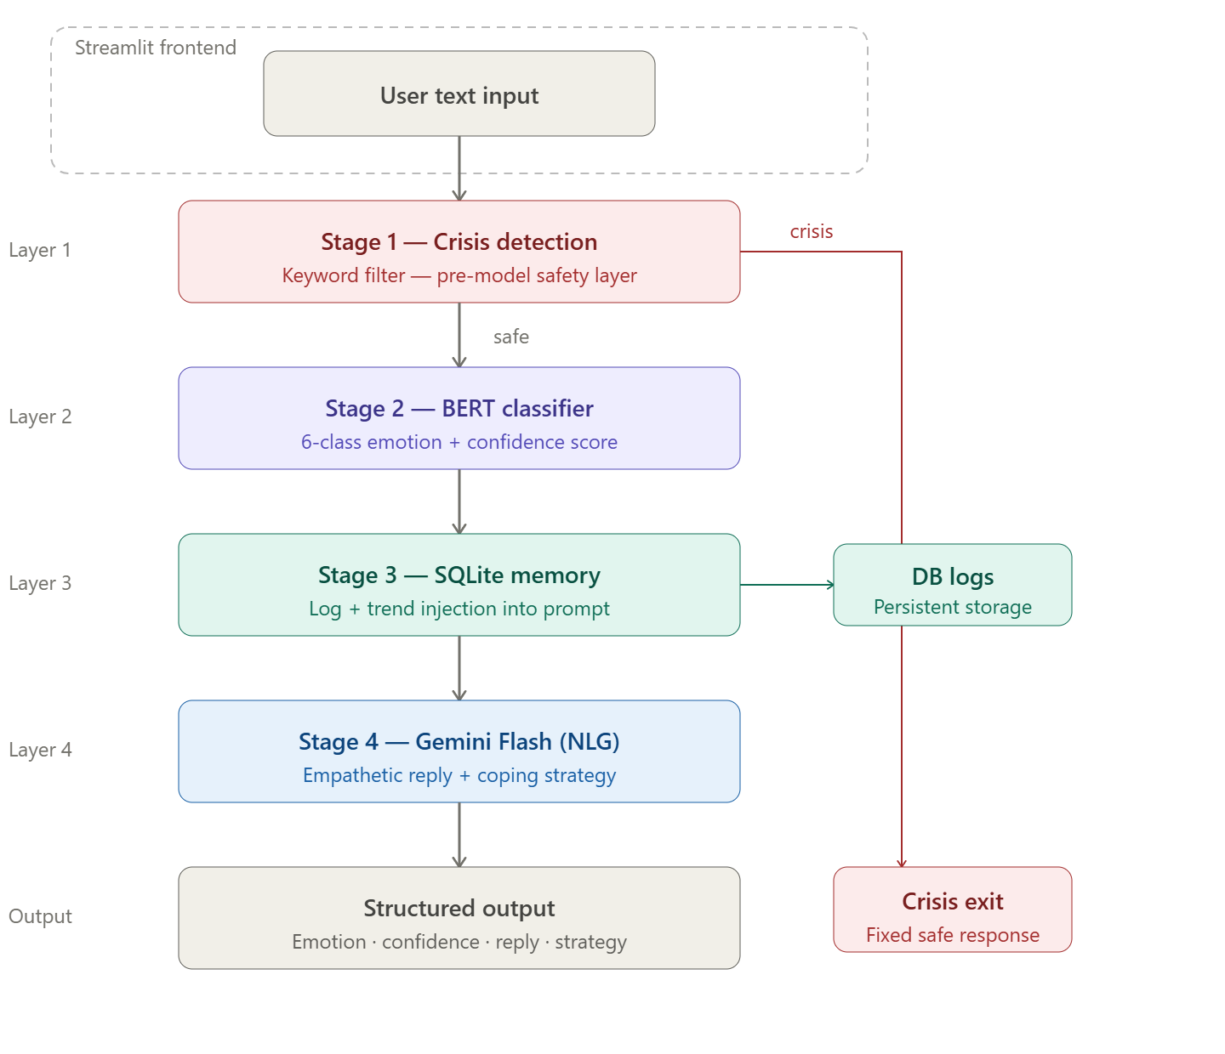
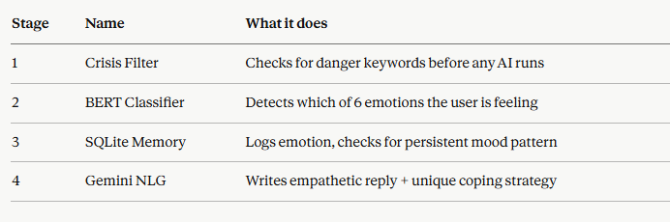
METHODOLOGY(SYSTEM PIPELINE)

Slide 6
BERT Fine-Tuning
Loaded dair-ai/emotion — 16,000 labelled sentences, 6 emotion classes
Tokenized text using WordPiece — max 512 tokens, dynamic padding
Added 6-class output layer on BERT's [CLS] token — ŷ = softmax(W · h_CLS + b)
Trained 2 epochs — AdamW, lr=5e-5, batch 64, T4 GPU — 517 seconds total
Best model auto-saved by lowest validation loss

Slide 7
Gemini Prompt Design
Every turn, Gemini receives a structured prompt containing:
  What user said — exact input text
  BERT result — emotion label + confidence score
  Trend note — from SQLite if same emotion repeated 3 times
  Chat history — last 5 conversation turns
Gemini returns:
  [MSG] → warm empathetic response
  [STRAT] → unique coping strategy, never repeated
  If Gemini fails → safe fallback message returned automatically

Slide 8
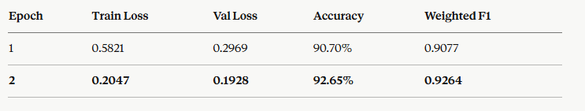
Quantitative Results
Training loss dropped from 0.5821 to 0.2047 — model learned rapidly without overfitting
Validation loss consistently decreased — best checkpoint correctly selected at epoch 2
92.65% accuracy and F1 = 0.9264 achieved in just 517 seconds on a free Colab G

Slide 9
CONCLUSION
Separating emotion classification (BERT) and response generation (Gemini) produces more emotionally grounded responses than a single end-to-end LLM
Fine-tuned BERT achieves 92.65% accuracy and F1 = 0.9264 — a reliable local classifier that runs fully offline without cloud dependency
Deterministic crisis detection + SQLite trend memory + LLM-generated strategies together solve the three failures of existing systems — unsafe responses, stateless conversations, and generic suggestions

Slide 10
FUTURE SCOPE
Learned Crisis Classifier:
    What: Replace keyword filter with a trained clinical model
    Why: Detects indirect, misspelled, and nuanced distress signals
Multilingual Support
    What: Fine-tune XLM-R for Malayalam + Indian languages
    Why: Users express emotions in native and mixed languages

Slide 11

REFERENCES:
[1] L. Balcombe, “AI chatbots in mental health care: Integrative review of challenges and solutions,” 2025.[2] (Authors TBD), "FL-Swarm MRCM: A novel federated learning framework for cross-site medical image reconstruction," Big Data and Cognitive Computing, vol. 9, no. 11, p. 295, Nov. 2025, doi: 10.3390/bdcc9110295. [Online]. Available: https://www.mdpi.com/2504-2289/9/11/295
[2] A. Cabrera Lozoya et al., “Leveraging large language models for simulated psychotherapy client interactions: Development and usability study of Client101,” 2025.[4] J. Hu, Z. Yang, P. Wang, G. Zhao, H. Huang, Z. Zong, and D. O. Wu, "Federated learning for medical image analysis: Privacy-preserving paradigms and clinical challenges," Image and Vision Technology, p. 2508001101, Aug. 2025. [Online]. Available: https://www.sciltp.com/journals/iwt/articles/2508001101
[3] A. Fahmi and E. Nababan, “A comparative study of BERT and RoBERTa for sentiment analysis on Twitter data related to mental health,” 2025.[6] H. Xiao, Z. Yang, T. Liu, S. Liu, X. Huang, and J. Dai, "Deep learning for medical imaging super-resolution: A comprehensive review," Computer Methods and Programs in Biomedicine, 2025. [Online]. Available: https://www.sciencedirect.com/science/article/abs/pii/S092523122500339X
[4] I. Gabriel et al., “Can AI relate: Testing large language model response for mental health support,” 2024.
[5] Y. Hua et al., “A scoping review of large language models for generative tasks in mental health care,” 2025.[9] P. Nandal, S. Pahal, A. Khanna, and P. R. Pinheiro, "Super-resolution of medical images using Real-ESRGAN," IEEE Access, vol. 12, pp. 176155–176170, 2024, doi: 10.1109/ACCESS.2025.3497002.
[6] J. Kang and H. Hong, “Development and evaluation of a mental health chatbot using ChatGPT 4.0: Mixed methods user experience study with Korean users,” 2025.
[7] S. Kulkarni and A. Wadhekar, “AI mental health therapist,” 2025.
[8] T. Lecourt et al., “Only ChatGPT gets me: An empirical analysis of GPT versus other large language models for emotion detection in text,” 2025.

